Slide 1
Data import
Programming for Data Analysis (CT127-3-2-PFDA and Version VC1)

Slide 2
Topic & Structure of the lesson
Data Import
Access data included with R
Read data into a vector or list
Read CSV files
Read large data files
Read Excel files
Read from Databases

Slide 3
Learning outcomes
At the end of this topic, you should be able to:
Understand how to read data from various sources

Slide 4
Key terms you must be able to use
If you have mastered this topic, you should be able to use the following terms correctly in your assignments and exams:
CSV files
Excel files
Databases
Packages and functions that can be used to read data from various sources

Slide 5
Access data included with R
R and some packages come with data included.
To list the data sets in all *available* packages:
data(package = .packages(all.available = TRUE))
To load any data set use the data function:
data(diamonds, package=“?")
Data set name
The package that contain the data set

Slide 6
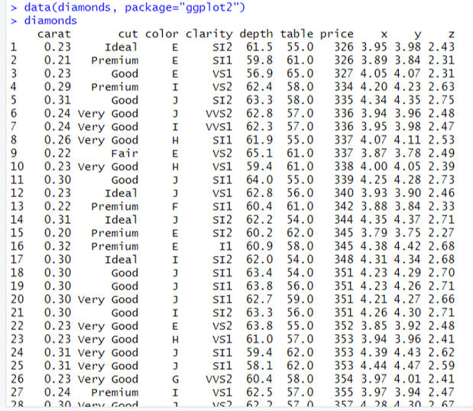
Access data included with R

Slide 7
Read data into a vector or list
Use scan to read data into a vector or list from the console or file.
IDs= scan(file=“?”)
The path and the name of a file to read data values from

Slide 8
Read data into a vector or list
library(crayon)
IDs= scan(file="C:\\emp.txt")
for(i in IDs)
{
deptID = i %/% 100
if (deptID==1)
{message(red(i))}
else if (deptID==2) {message(green(i))}
else {message(blue(i))}
}
140
253
137
358
279

Slide 9
Read CSV files
A comma-separated values (CSV) file is a delimited text file that uses a comma to separate values.
read.table is used to read data from a CSV file.
The result of using read.table is a data.frame.
read.csv, which is a wrapper around read.table with the sep argument preset to a comma (,).
read.table(file=“?”, header=TRUE, sep=“?")
read.csv(file =“?”, header = TRUE, sep = “?”)
The full path of the file to be loaded
A logical value indicating whether the file contains the names of the variables as its first line.
The delimiter separating data cells

Slide 10
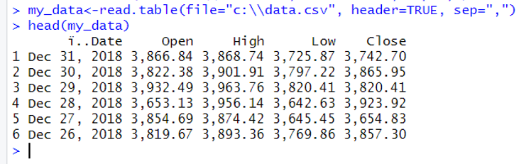
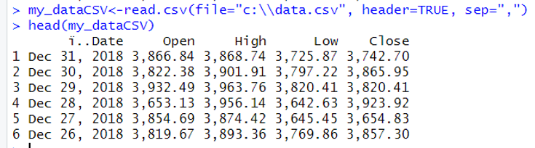
Read CSV files

Slide 11
Read large data files
Large files can be slow to read into memory using read.table. fread from the data.table package can be used instead of read.table.
library(data.table)
fread(input=“?”, sep=“?”, header=TRUE)
The full path of the file to be loaded
A logical value indicating whether the file contains the names of the variables as its first line.
The delimiter separating data cells

Slide 12
Read large data files
read_delim from the reader package can also be used when working with large data. It returns a tibble, which is an extension of data.frame.
library(reader)
read_delim(file=“?”, delim=“?”, col_names = TRUE)
The full path of the file to be loaded
A logical value indicating whether the file contains the names of the variables as its first line.
The delimiter separating data cells

Slide 13
Read large data files
library(data.table)
f1<-fread(input="c:\\data.csv", sep=",", header=TRUE)
library(reader)
f2<-read_delim(file="c:\\data.csv", delim=",", col_names =TRUE)

Slide 14
Read Excel files
The package readxl can be used to read Excel files, both .xls and .xlsx.
The result is a tibble rather than a traditional data.frame.
library(readxl)
read_excel(path=“?”, sheet =“?”)
The full path of the file to be loaded
Sheet to read. Either a string (the name of a sheet), or an integer (the position of the sheet)

Slide 15
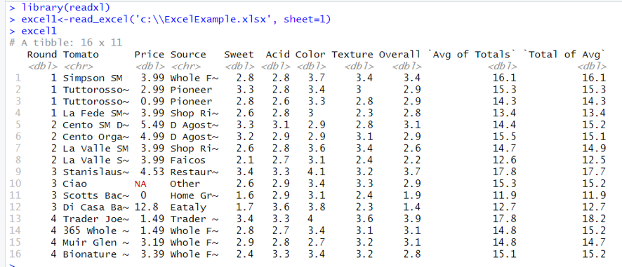
Read Excel files

Slide 16
Read from Databases
Nowadays, there are different types of database software.
The most popular open-source databases have packages such as RPostgreSQL and RMySQL. Other databases without a specific package can make use of the more generic, and aptly named, RODBC package.
Here, a simple SQLite database will be used.

Slide 17
Read from Databases
library(RSQLite)
Db<-download.file("http://www.jaredlander.com/data/diamonds.db",
destfile = “c:\\ diamonds.db", mode='wb')
drv <- dbDriver('SQLite')
specify the driver
con <- dbConnect(drv, "c:\\diamonds.db")
establish a connection
Additional arguments are typically the database username, password, host and port.
> dbListTables(con)
[1] "DiamondColors" "diamonds" "sqlite_stat1"
> dbListFields(con, name='diamonds')
[1] "carat" "cut" "color" "clarity" "depth" "table"
[7] "price" "x" "y" "z"
> dbListFields(con, name='DiamondColors')
[1] "Color" "Description" "Details"

Slide 18
Read from Databases
diamondsTable <- dbGetQuery(con,"SELECT * FROM diamonds",
stringsAsFactors=FALSE)
Head(diamondsTable)
longQuery <- "SELECT * FROM diamonds, DiamondColors
WHERE diamonds.color = DiamondColors.Color"
diamondsJoin <-dbGetQuery(con, longQuery, stringsAsFactors=FALSE)
head(diamondsJoin)
dbDisconnect(con)

Slide 19
Quick Review Questions
How to access data included with R ?
How to read data into a vector or list?
How to read CSV files?
How to read large data files?
How to read Excel files?
How to read from databases?

Slide 20
Summary of Main Teaching Points
Access data included with R.
Read data into a vector or list.
Read CSV files.
Read large data files.
Read Excel files.
Read from databases.

Slide 21
Q & A

Slide 22
Next Session
Data Visualization
Line graph
Bar chart
Histogram
Scatter plot
Box plot

